Slide 1


Department of Emerging Technology (SB)
III B.Tech –I Semester
MACHINE LEARNING LABORATORY
Subject/Course Code:22PCOAM18
Team Members: M.GAYATRI DEVI(22WJ8A6637)
M.BHAVANI(22WJ8A6638)
M.SAI KIRAN(22WJ8A6639)
M.NIKHIL REDDY(22WJ8A6640)
Topic:HANDWRITTEN DIGIT PREDICTION
Class/Sec:AIML-1

Slide 2
Introduction to Handwritten Digit Recognition
Handwritten digit recognition is a common task in machine learning and computer vision.
It involves identifying digits from images of handwritten text.
This project aims to use machine learning algorithms to automate this process.
Notes:
Image source: https://projectgurukul.org

Slide 3
Problem Statement
The recognition of handwritten digits can be challenging due to variations in writing styles.
Traditional methods may not achieve high accuracy levels in digit recognition.
This project seeks to address these challenges using machine learning techniques.
Notes:
Image source: https://www.slidemake.com

Slide 4
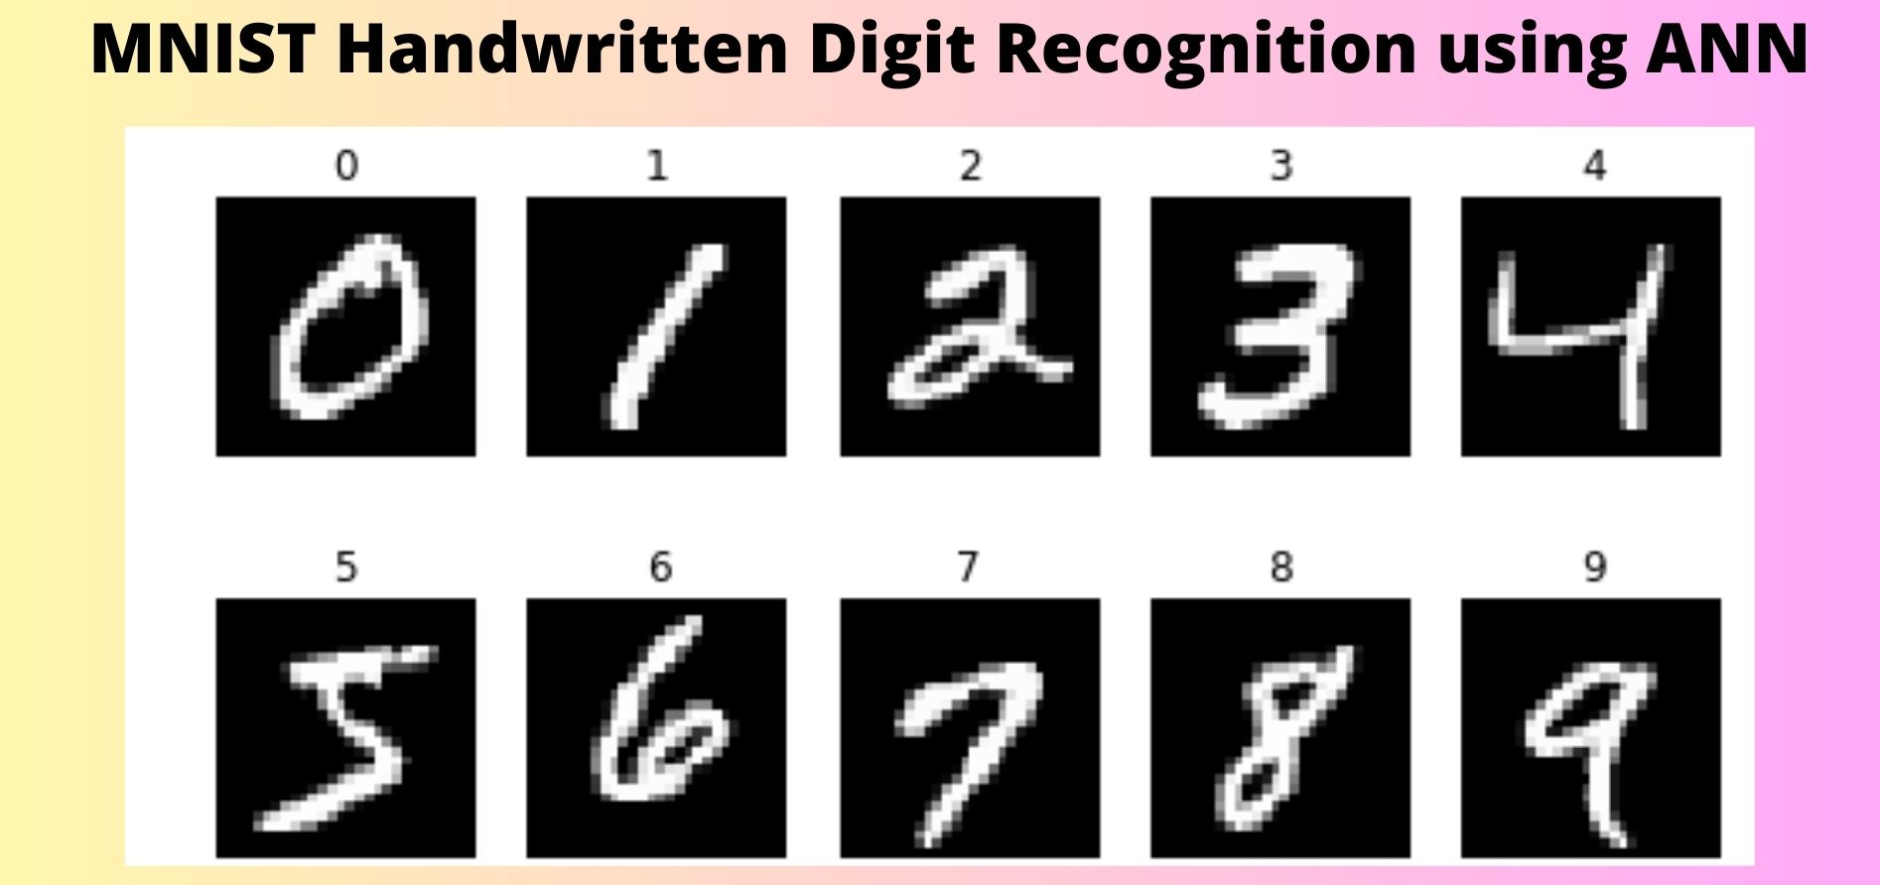
Dataset Overview
The MNIST dataset is commonly used for handwritten digit recognition.
It contains 70,000 images of handwritten digits, with each image being 28x28 pixels.
The dataset is split into training and testing sets for model evaluation.
Notes:
Image source: https://user-images.githubusercontent.com

Slide 5
Data Preprocessing
Preprocessing is essential for preparing the images for machine learning models.
Steps include normalization, resizing, and converting images to grayscale.
Data augmentation techniques can also be applied to improve model robustness.
Notes:
Image source: https://www.slidemake.com

Slide 6
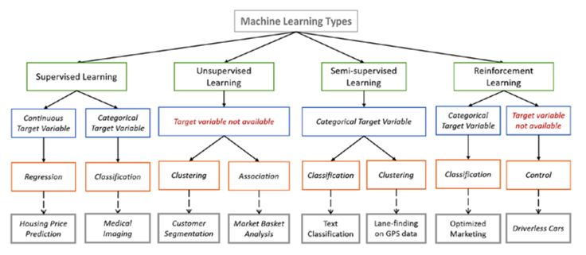
Machine Learning Algorithms
Various machine learning algorithms can be used for digit recognition.
Common choices include Convolutional Neural Networks (CNNs) and Support Vector Machines (SVMs).
Each algorithm has its strengths, impacting accuracy and training time.
Notes:
Image source: https://i.pinimg.com

Slide 7
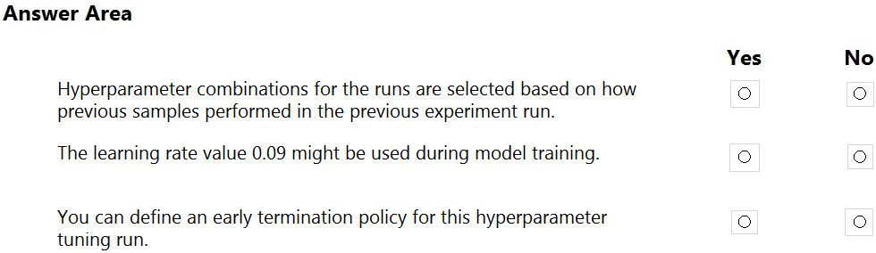
Model Training
The training process involves feeding the model with labeled data from the training set.
Hyperparameter tuning is crucial to optimize the model's performance.
The model learns to recognize patterns and features within the handwritten digits.
Notes:
Image source: https://www.examtopics.com

Slide 8
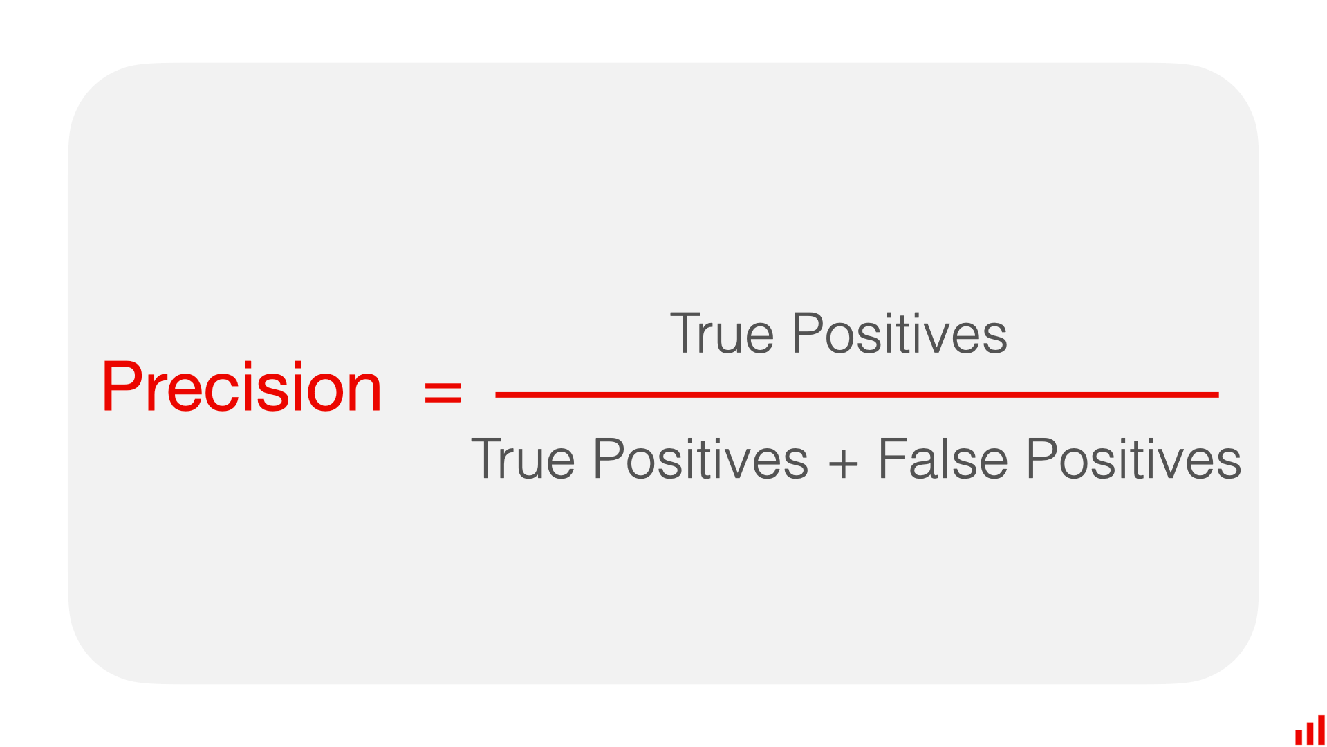
Model Evaluation
Evaluation metrics such as accuracy, precision, and recall are used to assess performance.
The model is tested against the unseen test dataset to gauge its effectiveness.
Confusion matrices can help visualize the classification results.
Notes:
Image source: https://uploads-ssl.webflow.com

Slide 9
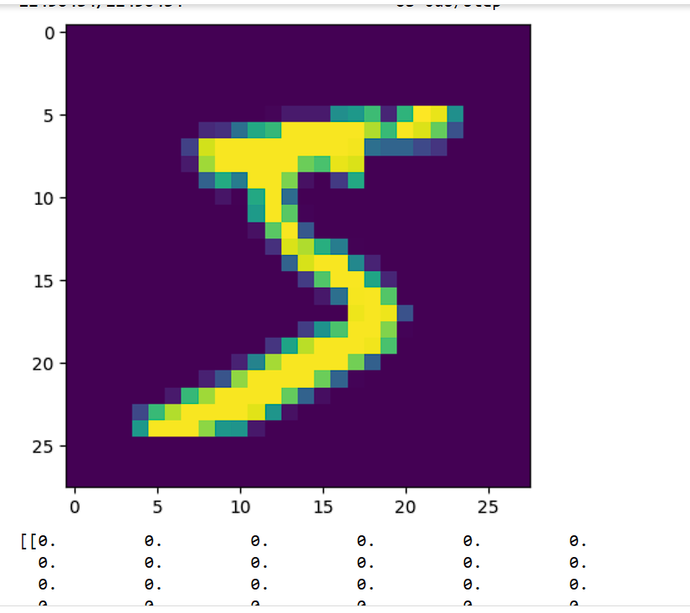
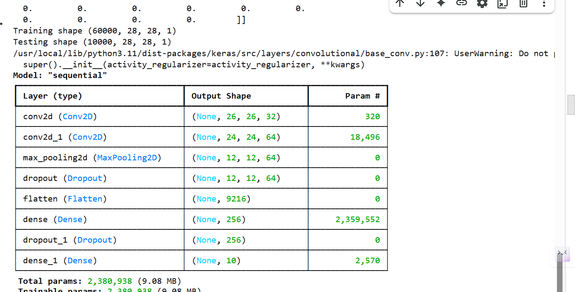
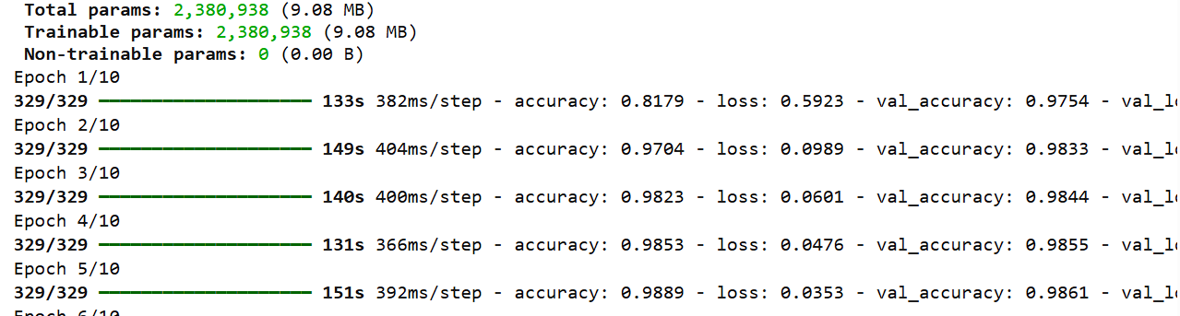
Results and Analysis
The trained model's performance is analyzed based on evaluation metrics.
Comparisons are made between different algorithms to identify the best performer.
Insights from the results can guide future improvements in model development.
CNN achieves ~99.3% accuracy on MNIST
Simple ML models: ~94%–97%
Data augmentation boosts performance
Notes:
Image source: https://www.researchgate.net

Slide 10
Challenges and Limitations
Challenges such as overfitting and underfitting can impact model performance.
Variability in handwriting styles can lead to misclassification of digits.
Addressing these limitations is crucial for enhancing recognition accuracy.
Notes:
Image source: https://www.slidemake.com

Slide 11
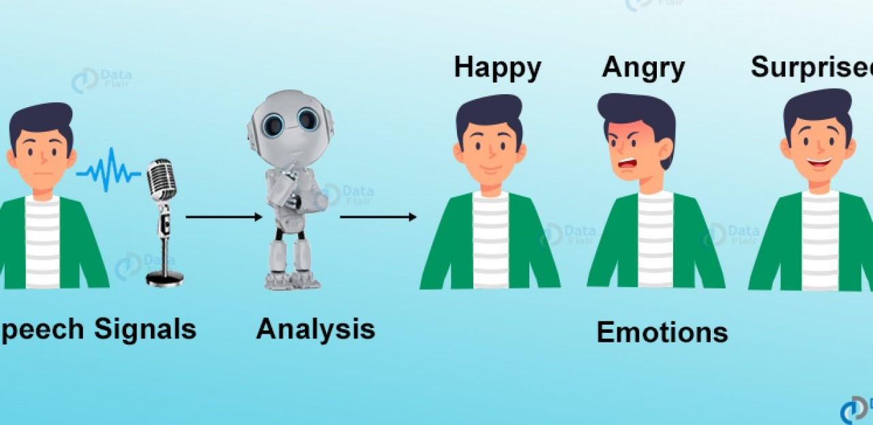
Conclusion and Future Work
The project successfully demonstrates the use of machine learning for digit recognition.
Future enhancements could include using deeper models and more extensive datasets.
Continued research will contribute to more accurate and robust handwriting recognition systems.
Notes:
Image source: https://user-images.githubusercontent.com

